Slide 1
Introducing
Onboarding
The Onboarding process allows new and rehired employees to be work ready on their first day of employment.

Slide 2
Onboarding Overview
By running the HCM transaction
ZPONBOARD
new hires and rehires will have access to the Onboard tab in LEO prior to and on their start date.

Slide 3
Onboarding Tab
Allows employees to enter personal information, view links to additional info, and attest to reading your agency policies prior to their start date or during their first pay period.
Eliminates the need for excess paper, streamlines the orientation process, and cuts down on the time employees are without LaGov security access.

Slide 4
Onboarding Process
Prior to an employee’s start date, HR gathers information needed to execute the transaction ZPONBOARD.
Start Date
Social security number
Name
Date of birth
Personal email address
Position number
HR executes transaction ZPONBOARD.
If it’s a new hire, it will create a personnel number.
If it’s a rehire, it will run ZPREHIRE in the background.
ZPONBOARD gives the employee the Onboard tab in LEO and generates an email to the employee with their personnel number and a link to LEO.
Employee will go to LEO and create a password to logon.

Slide 5
Onboarding Process
Employee will see a Welcome page which can contain agency specific text.
Employee will click on links on the Onboard tab under detailed navigation to save or view:
Addresses
Emergency contact
Bank detail
Tax withholdings
Policies
Additional Info
Prior State Service
HR Onboarding email group receives a notification email when the employee saves bank details and verifies they have read agency policies.

Slide 6
Onboarding Process
Policies Link
Employees will see links to agency specific policies. These links are maintained by the HCM Help Desk, eliminating the need for the agency IT Department to create a new employee page.
Employees will click on an I Verify button, verifying they have read and understood policies.
HR will receive an email to let them know the employee has verified reading the policies.
ZP13 will be updated. A new column has been added named Attest-Policy.

Slide 7
Onboarding Process
Additional Info Link
Employees will see links to any other policies or websites the agency would like to display.
Examples may include; Office of Group Benefits, Retirement Benefits, or Louisiana.gov.
The employee will not verify reading additional links.

Slide 8
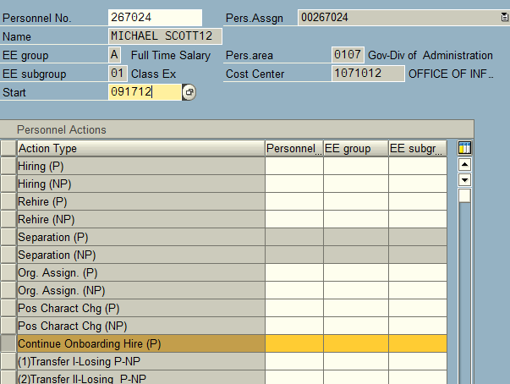
Onboarding Process
HR will complete the hire in PA40 using a Continue Onboard Hire or Rehire Action.

Slide 9
Onboard Tab
+
Standard welcome page text. Text can be customized per agency request.

Slide 10
Onboard Tab
Employee will enter or view:
Permanent/mailing address
Emergency Contact
Tax Withholdings
Bank Information
Policies
Additional Info

Slide 11
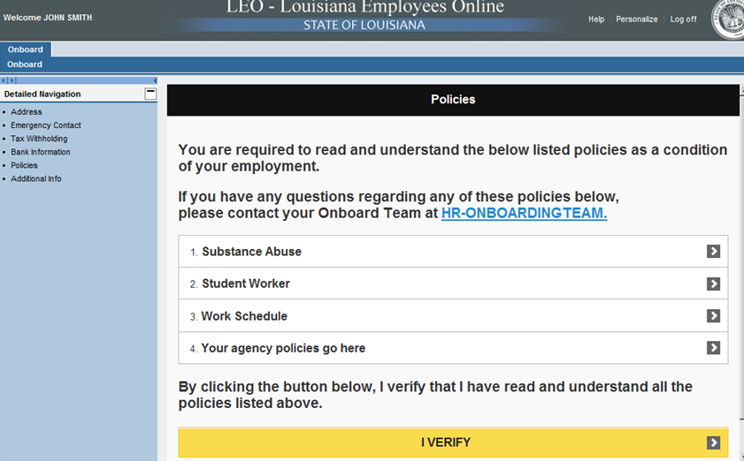
Policies Page
Example of agency specific policies.

Slide 12
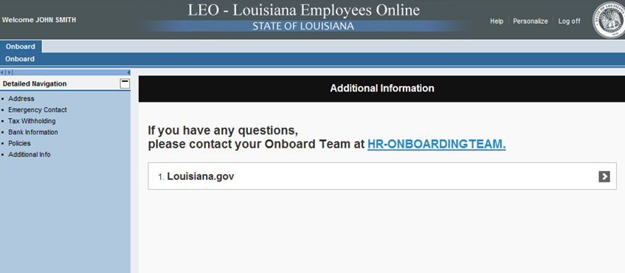
Additional Info Page
Example of agency specific additional info.

Slide 13
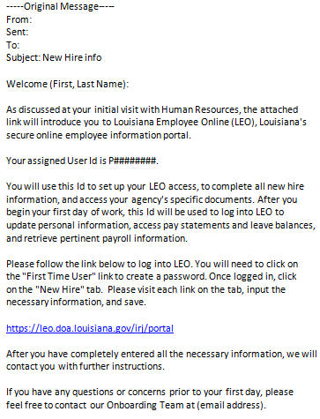
Email automatically generated to employee

Slide 14
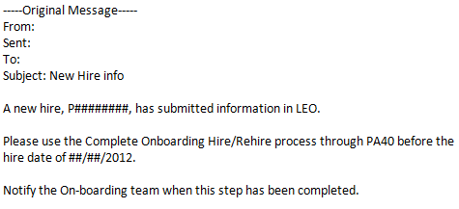
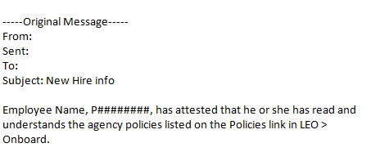
Emails automatically generated to HR Onboarding email group

Slide 15
What’s next?
Onboarding is available for use now
However, here are some things to consider…

Slide 16
What’s next?
Ask agency IT Department to create an Onboarding email group or use an existing email box. This email will be used to notify the HR recipients when an employee has saved personal information and read policies in LEO.
The HCM Help Desk will need the links to any policies you want your employees to verify reading and links to any other additional info. Otherwise, employees will see a message to contact HR.
Agencies may want to coordinate with their IT Departments to have LAN IDs and email boxes created prior to employee's first day of employment otherwise a personal email address can be used until a work email is created.
Notify Security Administrators of the Onboarding process to ensure any necessary LaGov position security has been requested and is in place prior to new employee’s start date.

Slide 17
What’s next?
Ask agency IT Department to create an Onboarding email group or use an existing email box. This email will be used to notify the HR recipients when an employee has saved personal information and read policies in LEO.
The HCM Help Desk will need the links to any policies you want your employees to verify reading and links to any other additional info. Otherwise, employees will see a message to contact HR.
Agencies may want to coordinate with their IT Departments to have LAN IDs and email boxes created prior to employee's first day of employment otherwise a personal email address can be used until a work email is created.
Notify Security Administrators of the Onboarding process to ensure any necessary LaGov position security has been requested and is in place prior to new employee’s start date.

